Slide 1










IILM UNIVERSITY, GREATER NOIDA
Operations Management & Customer Relations
Internship Completion Report Presentation
STUDENT NAME
ENROLLMENT NUMBER
PROGRAM & SEMESTER
Arpit Kumar
CS-2341033
B.Tech (CSE) | Sem - 7th
ORGANIZATION NAME
INTERNSHIP TENURE
BATCH
ACS Drymix
June 10 – August 10, 2026
2026-2027
IILM University | B.Tech CSE (Sem - 7th)
ACS Drymix Operations Internship

Slide 2
Internship Overview
Gaining hands-on operational excellence, dispatch management, and client relation skills in drymix manufacturing.
ACS Drymix | Operations Internship
Section 1

Slide 3


Executive Summary & Mandate
Professional Role
Core Responsibilities
Served as an Operations Intern at ACS Drymix from June 10, 2026, to August 10, 2026 under the mentorship of Mr. Rakesh (Operation Head).
Managed operational backend logs, structured spreadsheet databases, dispatch order pipelines, and direct customer query management.
Fulfilled core degree prerequisites for Bachelor of Technology in Computer Science & Engineering at IILM University, Greater Noida (Semester 7th).
Bridged analytical data processing with daily manufacturing execution and physical logistics coordination.
ACS Drymix | Operations Internship
Executive Summary

Slide 4

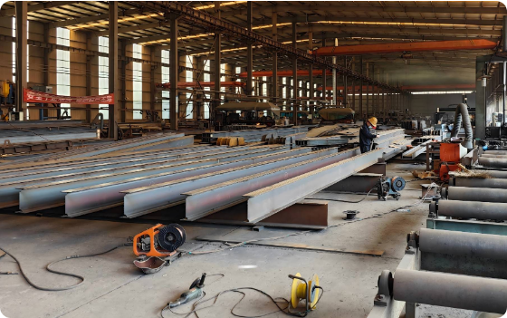
Organization Profile: ACS Drymix
ACS Drymix is a premier manufacturer and supplier of modern dry mix mortar products and specialized industrial building materials.
•
Product Lines: High-grade tile adhesives, wall putty, repair mortars, ready-mix plasters, and construction chemicals.
•
Operational Focus: High-volume inventory turnarounds, distributor order processing, and dispatch logistics.
•
Customer Engagement: Serving contractors, commercial builders, and retail distribution networks across regions.
ACS Drymix | Operations Internship
Company Profile

Slide 5






Core Project Objectives
Workflow Optimization
Data Integrity
Customer Relations
Understand industrial manufacturing workflows, inventory flow tracking, and dispatch schedule management.
Maintain precise digital logs, eliminating data discrepancies across client requisitions and inventory sheets.
Build standardized communication workflows to handle distributor calls, order updates, and grievances effectively.
ACS Drymix | Operations Internship
Objectives

Slide 6
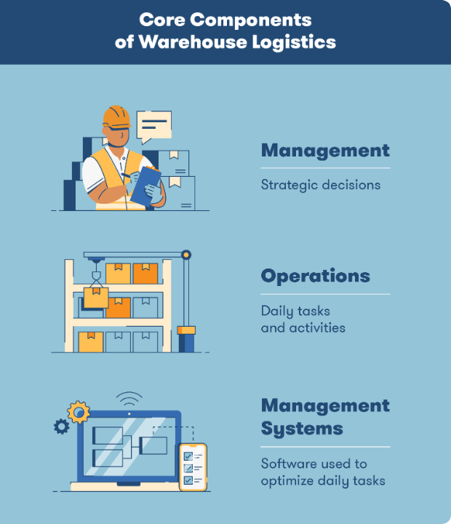
System Architecture
Integrated Operations Pipeline
1. Order Ingestion: Calls & emails logged into tracking sheets with validation checks.
2. Processing & Release: Verification of product SKU, batch size, and warehouse availability.
3. Dispatch & Tracking: Transport coordination and sharing delivery updates with clients.

Slide 7
Key Performance Highlights
60
Operational Results Achieved
• 100% Record Accuracy: Applied data validation rules, eliminating routine entry errors in dispatch logs.
• 35% Faster Response: Standardized client update templates, reducing customer query turnaround times.
Days of Industrial Tenure
• Systematic Escalation: Created structured grievance ledgers for seamless internal escalation.
ACS Drymix | Operations Internship
Performance Metrics

Slide 8
Methodology & Daily Workflow
Data Governance: Utilized Microsoft Excel & Google Sheets (VLOOKUP, Pivot Tables, Data Validation) for dispatch tracking.
Customer Relations: Handled client inquiries regarding pricing structures, stock availability, and delivery schedules.
Logistics Support: Liaised between plant leads, transport drivers, and sales personnel to ensure on-time dispatches.
Reporting & Auditing: Prepared daily dispatch summaries and organized physical delivery challans for administrative records.
ACS Drymix | Operations Internship
Methodology

Slide 9






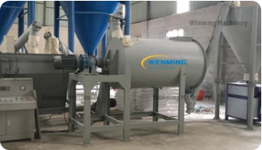


Operational Focus Pillars
Plant Operations
Customer Support
Dispatch Logistics
Tracking formulation dispatches for tile adhesives and mortar products.
Delivering prompt communication and resolving distributor inquiries.
Monitoring delivery timelines and transport movement across distribution networks.
ACS Drymix | Operations Internship
Key Pillars

Slide 10


Core Fundamentals Learned
Operational Knowledge
Professional Skills
• Data Governance: Learned how data precision directly prevents logistical delays and revenue leaks.
• Client Engagement: Addressed demanding client inquiries calmly with transparent status updates.
• Process Mapping: Deconstructed multi-stage warehouse workflows into measurable daily steps.
• Cross-Functional Work: Collaborated smoothly across plant staff, managers, and transport teams.
ACS Drymix | Operations Internship
Key Learnings

Slide 11
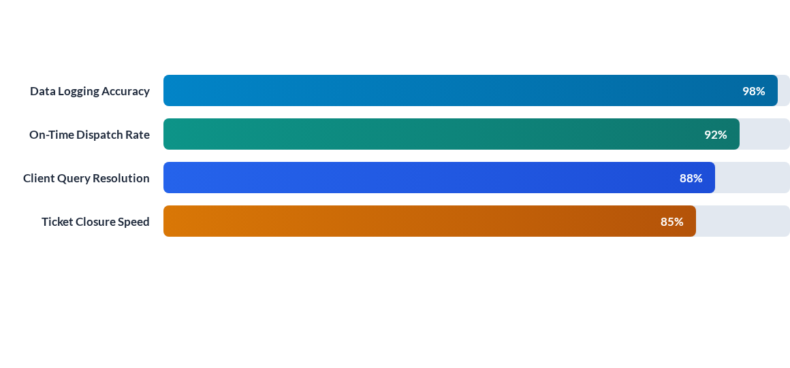
Process Optimization Impact
Implementation of structured spreadsheets and standardized communication templates led to significant operational efficiency gains during the 8-week tenure.
ACS Drymix | Operations Internship
Impact & Results

Slide 12
Thank You!
Questions & Feedback are Welcome.
IILM University | ACS Drymix Operations Internship
Q&A

Slide 13






Image Sources
https://f2.leadsquaredcdn.com/t/iilmuniversity/content/common/images/landingpages/circular%20logo-01.png
Source: admissions.iilm.edu
https://www.hhysteelstructure.com/wp-content/uploads/2025/06/346c4e2edb600a9f815610c27824daf11.jpg
Source: www.hhysteelstructure.com
https://acropolis-wp-content-uploads.s3.us-west-1.amazonaws.com/core-components-of-warehouse-logistics.webp
Source: www.bigrentz.com
https://cdn.shopify.com/s/files/1/0613/0643/7875/files/dry-mix-mortar-plant-supplier.jpg?v=1771491245
Source: wmmachinery.com
https://photos.peopleimages.com/picture/202310/2904683-team-portrait-and-call-center-consultant-group-with-arms-crossed-contact-us-with-headphones-and-help-desk.-professional-people-smile-diversity-and-customer-service-with-support-trust-and-advice-fit_400_400.jpg
Source: peopleimages.com
https://img.magnific.com/premium-vector/warehouse-dispatch-center-daily-outgoing-records_1210345-14456.jpg?semt=ais_hybrid&w=740&q=80
Source: www.magnific.com

